Slide 1

npm
node without npm, would be like .....

Slide 2
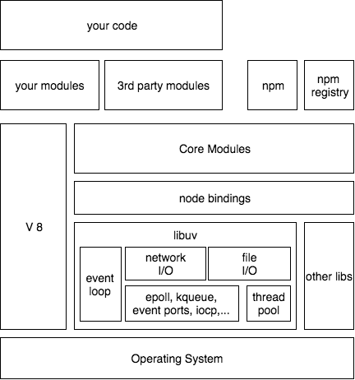
RECAP: npm and node.js
your code may use 3rd party modules
packages downloaded and installed by npm program
downloaded from npm registry
your modules can be published
to npm registry
using npm cli
you can reuse your own modules
others can reuse your modules
others can improove your modules

Slide 3
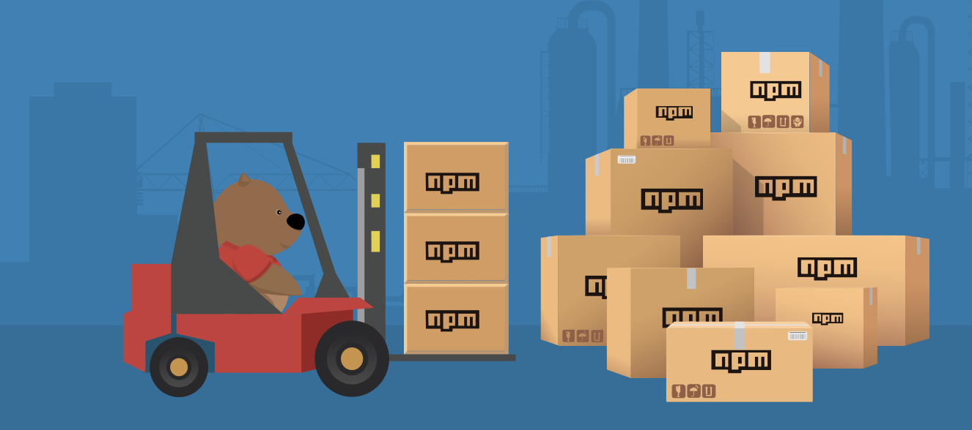
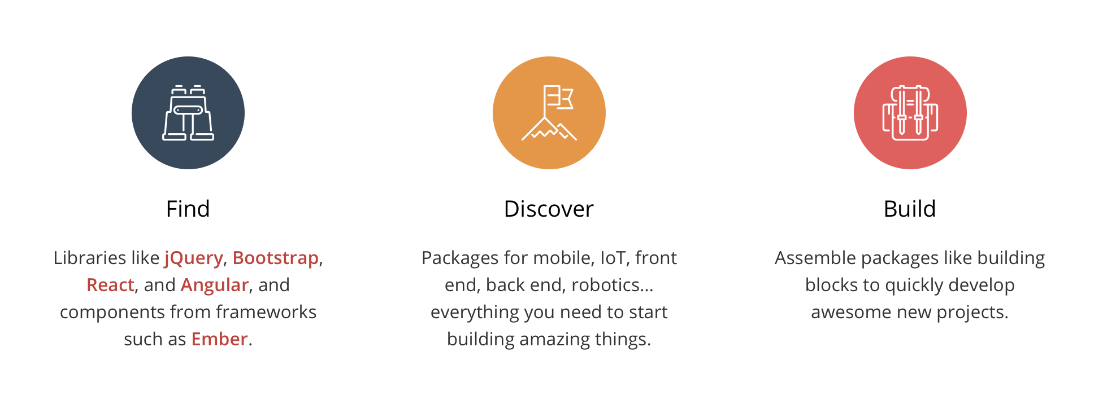
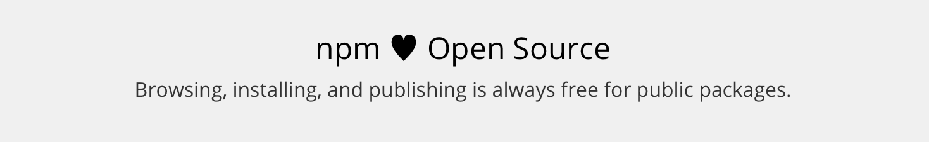
npm - https://www.npmjs.com/
npm is the:
package manager for JavaScript
and the world’s largest software registry
use npm to:
install,
share, and distribute code;
manage dependencies in your projects;
and share & receive feedback with others

Slide 4
npm - https://www.npmjs.com/
npm consists of three distinct components:
the registry
the Command Line Interface (CLI)
the website
The registry is a large public database of JavaScript software and the meta-information surrounding it.
The CLI runs from a terminal. This is how most developers interact with npm.
Use the website to discover packages, set up profiles, and manage other aspects of your npm experience. For example, you can set up Orgs (organizations) to manage access to public or private packages.

Slide 5
Terminology: modules vs. packages
node –> module
npm –> package
most npm packages are modules
Exception: Some packages can be only CLI, data, installs etc.
A module is anything that can be loaded with require()
JavaScript file
folder with an index.js file in it
folder with a package.json file containing a main field
A package is:
folder containing a program described by a package.json file or
git url, to folder
registry: <name>@<version>, <name>@<tag>, <name>
gzipped tarball
url to gzipped tarrbal
https://docs.npmjs.com/getting-started/packages#what-is-a-module

Slide 6
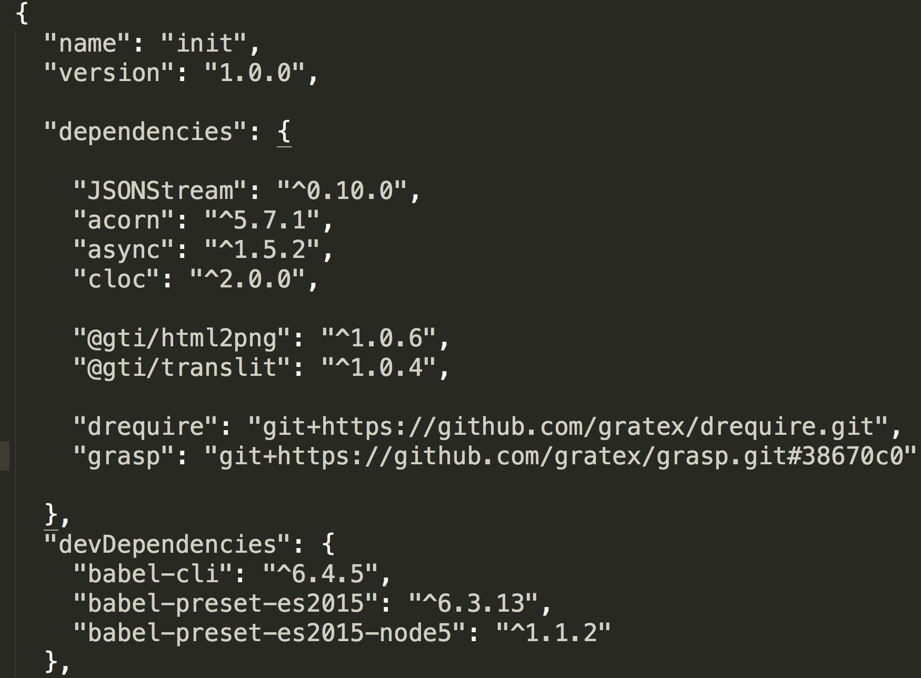
Packages - package.json
RECAP: npm helps you to manage dependencies
RECAP: Package is folder containing a program described by a package.json file .....
A package.json file:
lists the packages that your project depends on
with version of a packages that your project can use, using semantic versioning rules
...
npm registry
Local npm registry
from git url
https://docs.npmjs.com/getting-started/using-a-package.json, https://docs.npmjs.com/getting-started/semantic-versioning

Slide 7

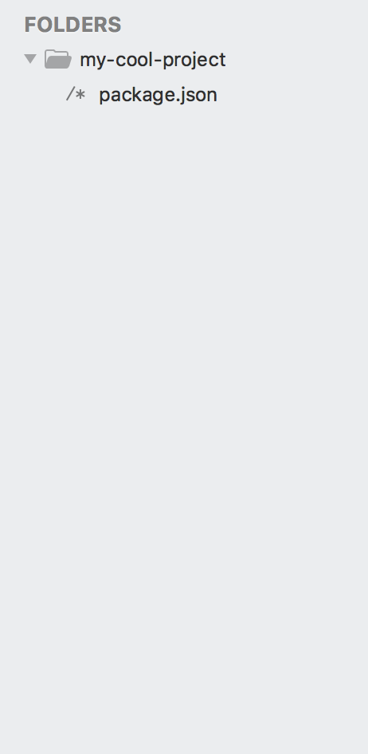
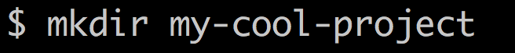


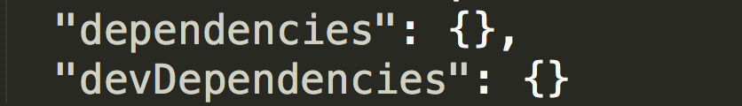

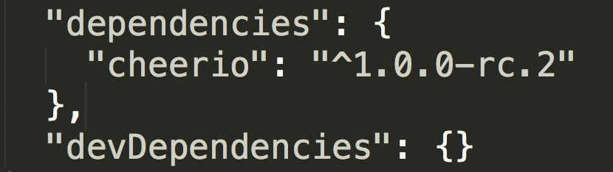
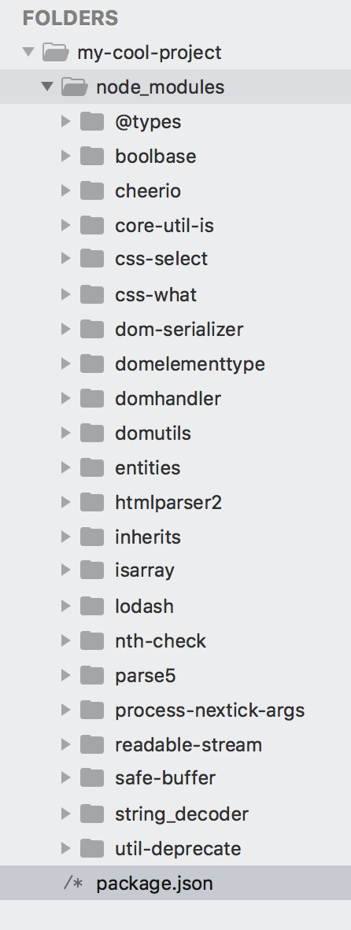
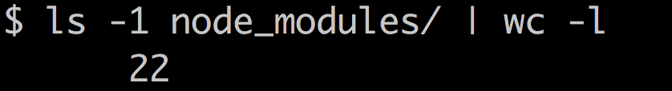
Dependencies - Installing
Your project = folder
Your project can be package (mostly is)
You add dependency to needed modules (install)
Dependency has dependencies and these are installed as well (or reused)
6 dependencies + 9 devDendenicies

Slide 8

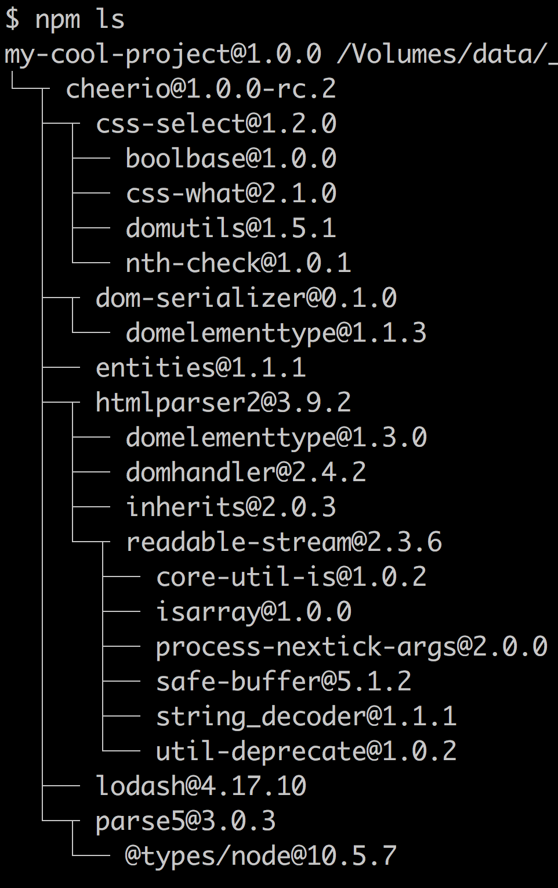
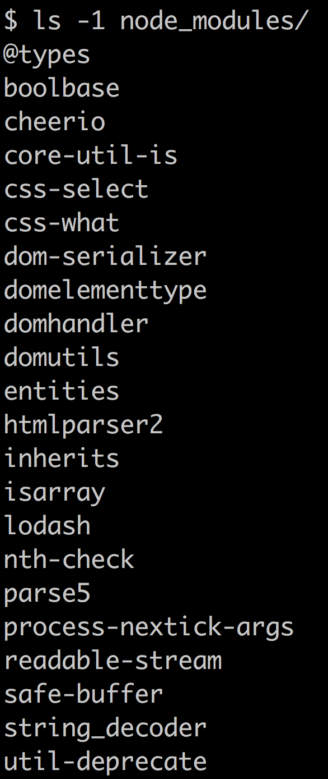
Dependencies - Tree
RECAP: we have installed one package and have 22 folders in node_modules
Packages - tree
Disk – flat + tree
Flat tree, if conflict of versions occurs, saves under module (not root)
Npm can install multiple versions of dependencies of dependencies
These would be installed under nested node_modules in the package folder
http://npm.github.io/how-npm-works-docs/npm3/how-npm3-works.html

Slide 9
package.json
originaly designed to manage dependencies
now mix of all possilble and extensible metadata

Slide 10
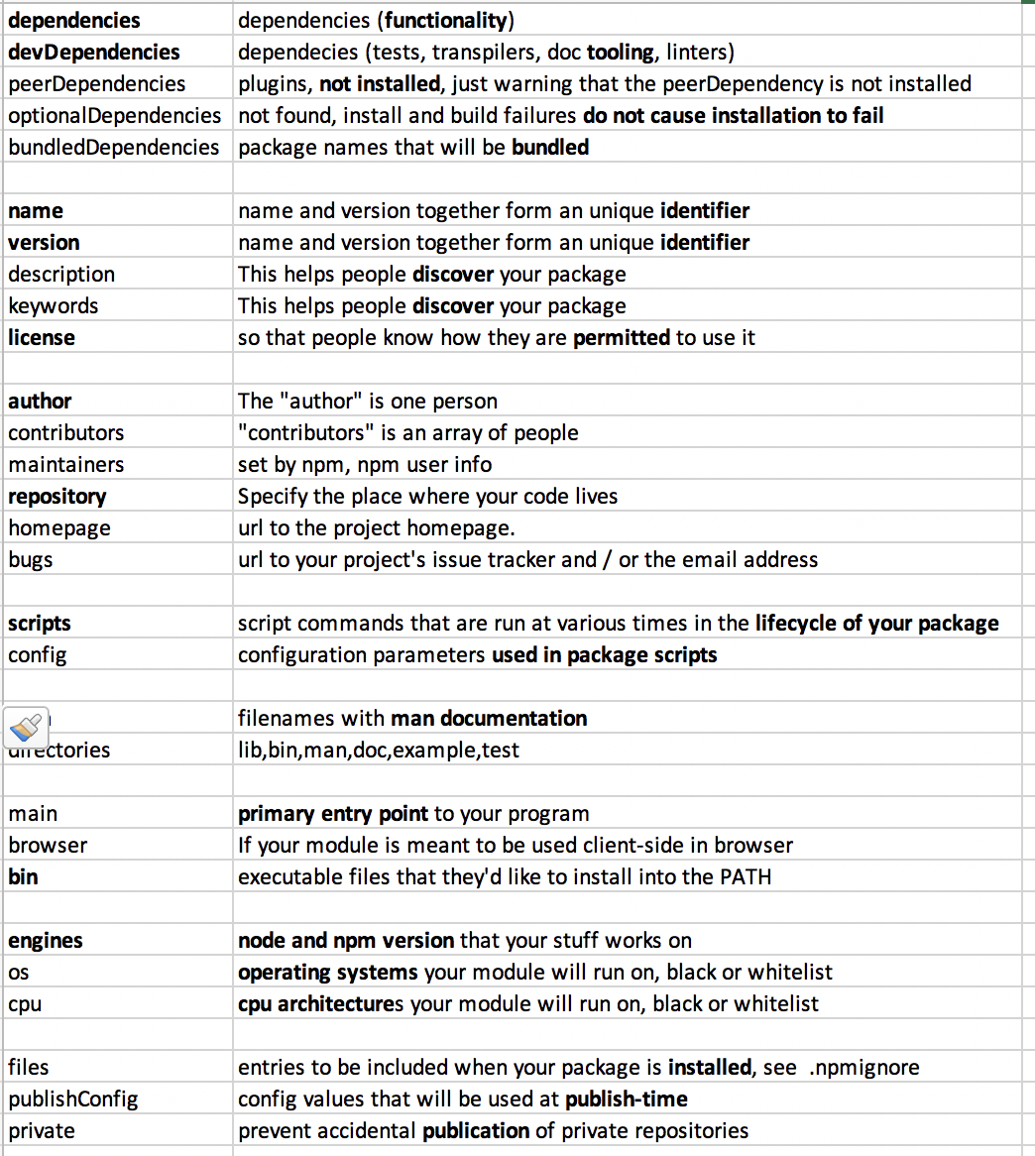
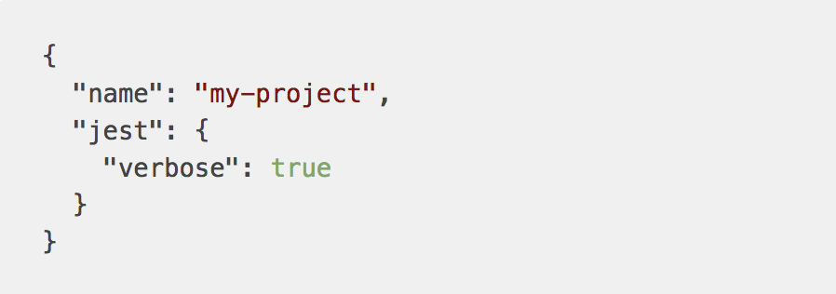
Package.json
Originaly designed for dependecies
Now – everything
+ allows for custom fields used by code directly
https://docs.npmjs.com/files/package.json

Slide 11
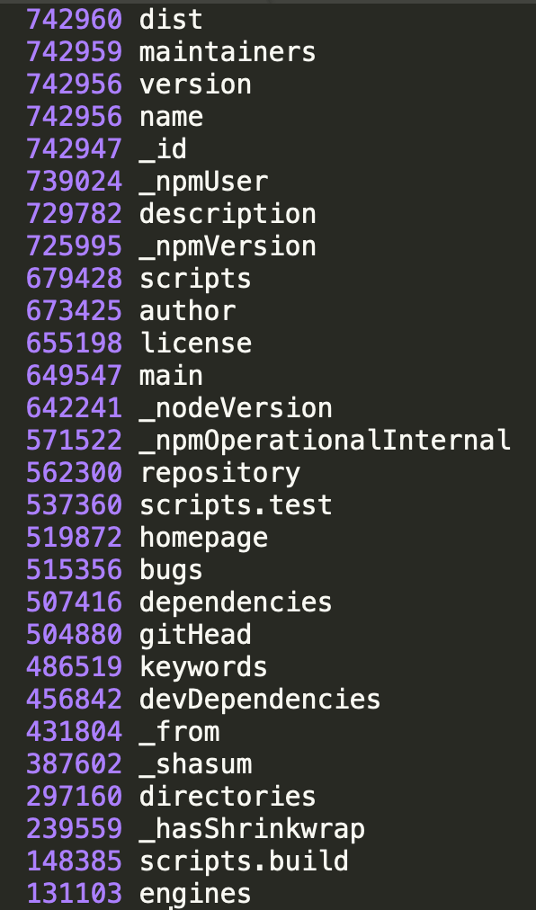
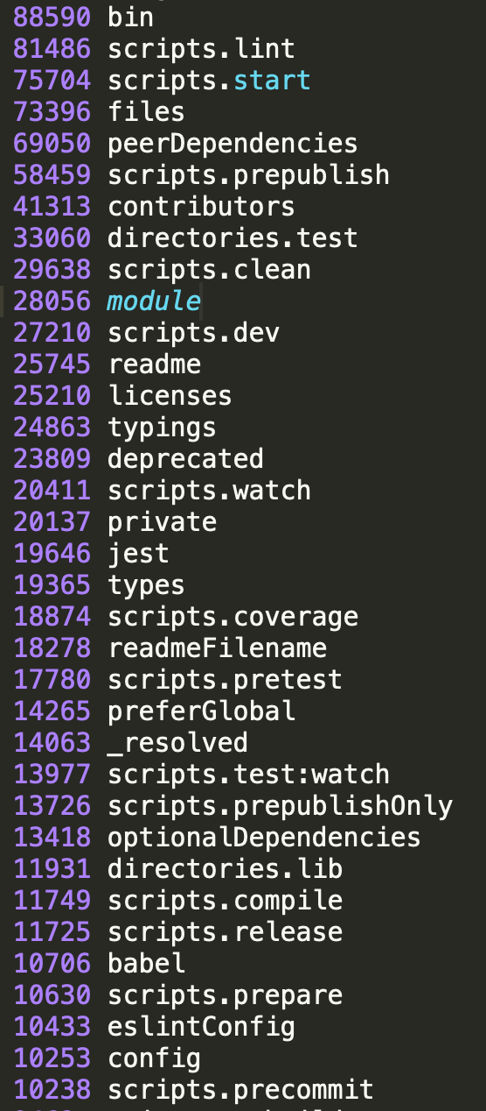
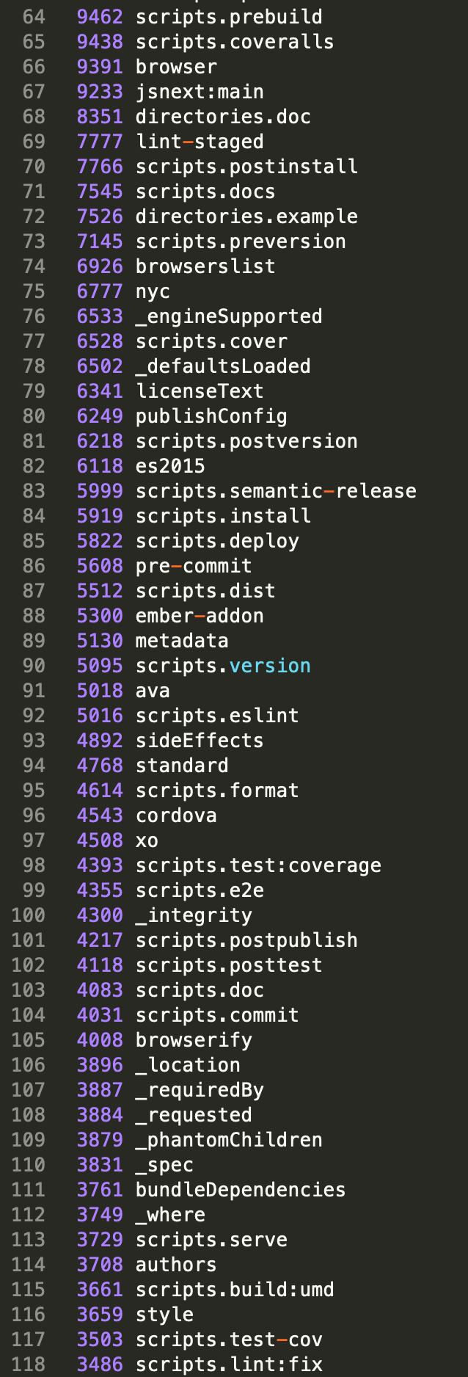
Package.json what properties are really used
Getting all npm packages and counting how many use what package.property
In order of magnitudes
X00 000
X0 000
X 000
In detail: are they really used ? And how ?
node src/list-props.js | cnt > out/list-props.js

Slide 12
versioning
semantic versioning
package lock files

Slide 13
Versioning – Semantic Versioning
It's important to communicate the extent of changes in a new release of code, because sometimes updates can break code that a package needs (called dependencies).
Semantic versioning (semver) is a standard that was designed to solve this problem.
MAJOR.MINOR.PATCH-labels
MAJOR version when you make incompatible API changes,
MINOR version when you add functionality in a backwards-compatible manner, and
PATCH version when you make backwards-compatible bug fixes.
Additional labels for pre-release and build metadata
https://semver.org/ , https://docs.npmjs.com/getting-started/semantic-versioning

Slide 14
Versioning – Semantic Versioning
Máme 3 čísla, ktoré treba správne uvádzať vo vašich packages
a správne ich uvádzať pri dependenciách na iné packages
MAJOR.MINOR.PATCH
1 . 0 . 4
incompatible API changes
add functionality, backward-compatible
bug fixes, optimization,…
backward-compatible
MAJOR releases
*
x
MINOR releases
^1.0.4
1.x
1
PATCH releases
~ 1.0.4
1.0
1.0
Niekoľko spôsobov ako to napísať

Slide 15
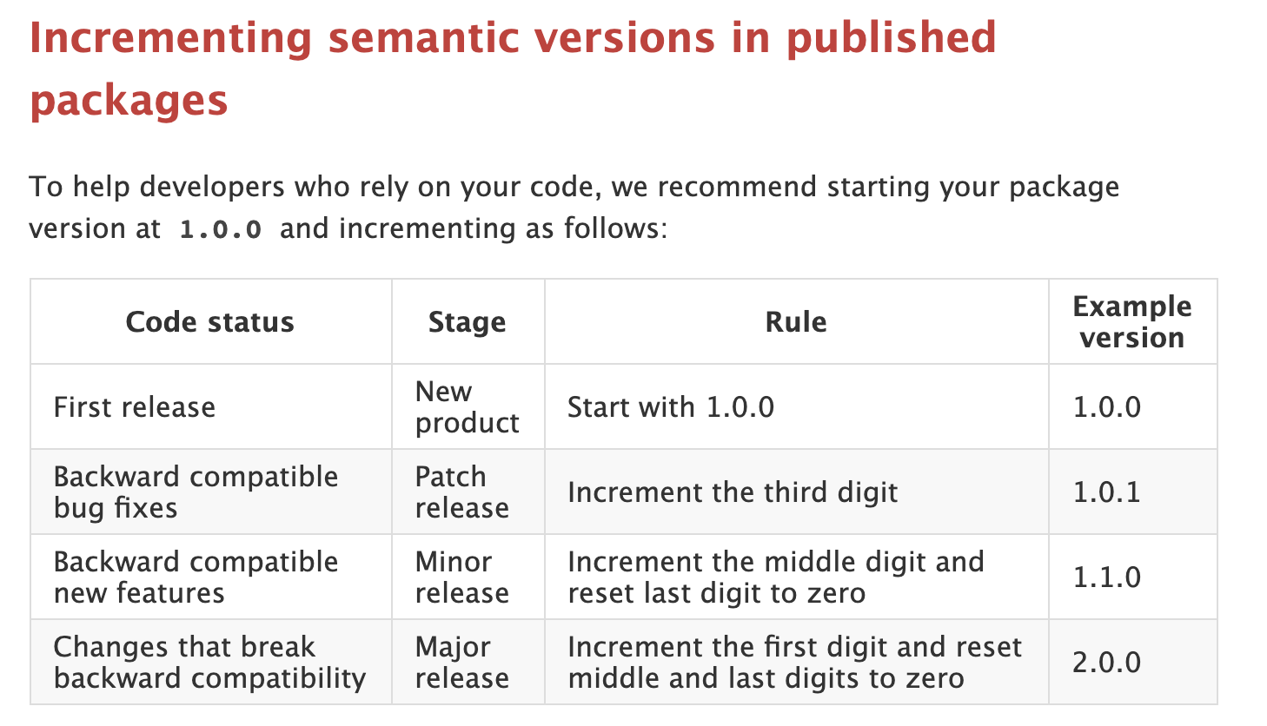
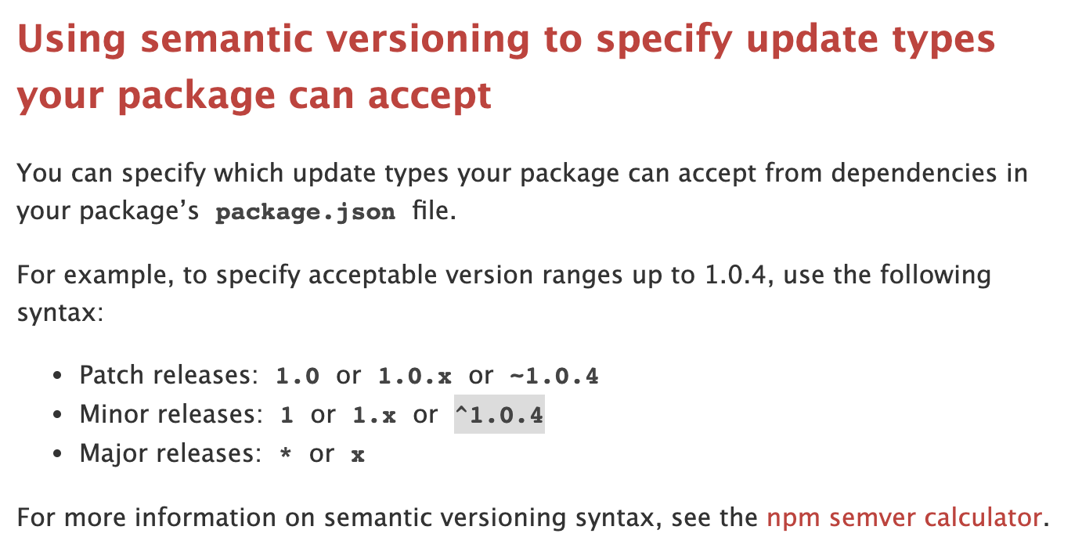
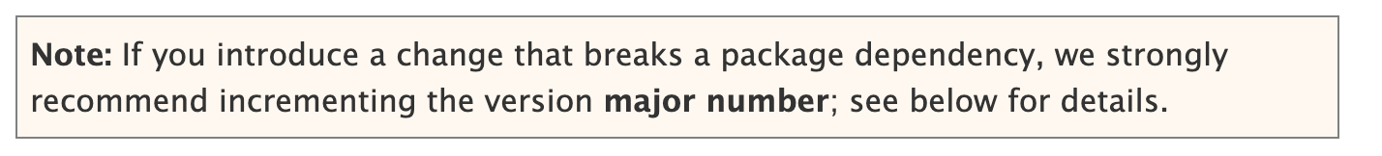
Semantic versioning
Bavíme sa o dvoch veciach:
https://docs.npmjs.com/about-semantic-versioning
Using other packages
Authoring your packages
Keď inštalujete package, nainštaluje sa v nejakej verzii
Buď
ju uvediete pri npm install alebo
sa použije „current“
Podľa toho aký „range“ uvediete, bude sa package inštalovať (npm install) a následne updatovať (npm update)
Cieľ je aby ste ostali up-to date (latest) z pohľadu fixov, prípadne z pohľadu latest funkcionality
Aké verzie dávať vašim packages

Slide 16
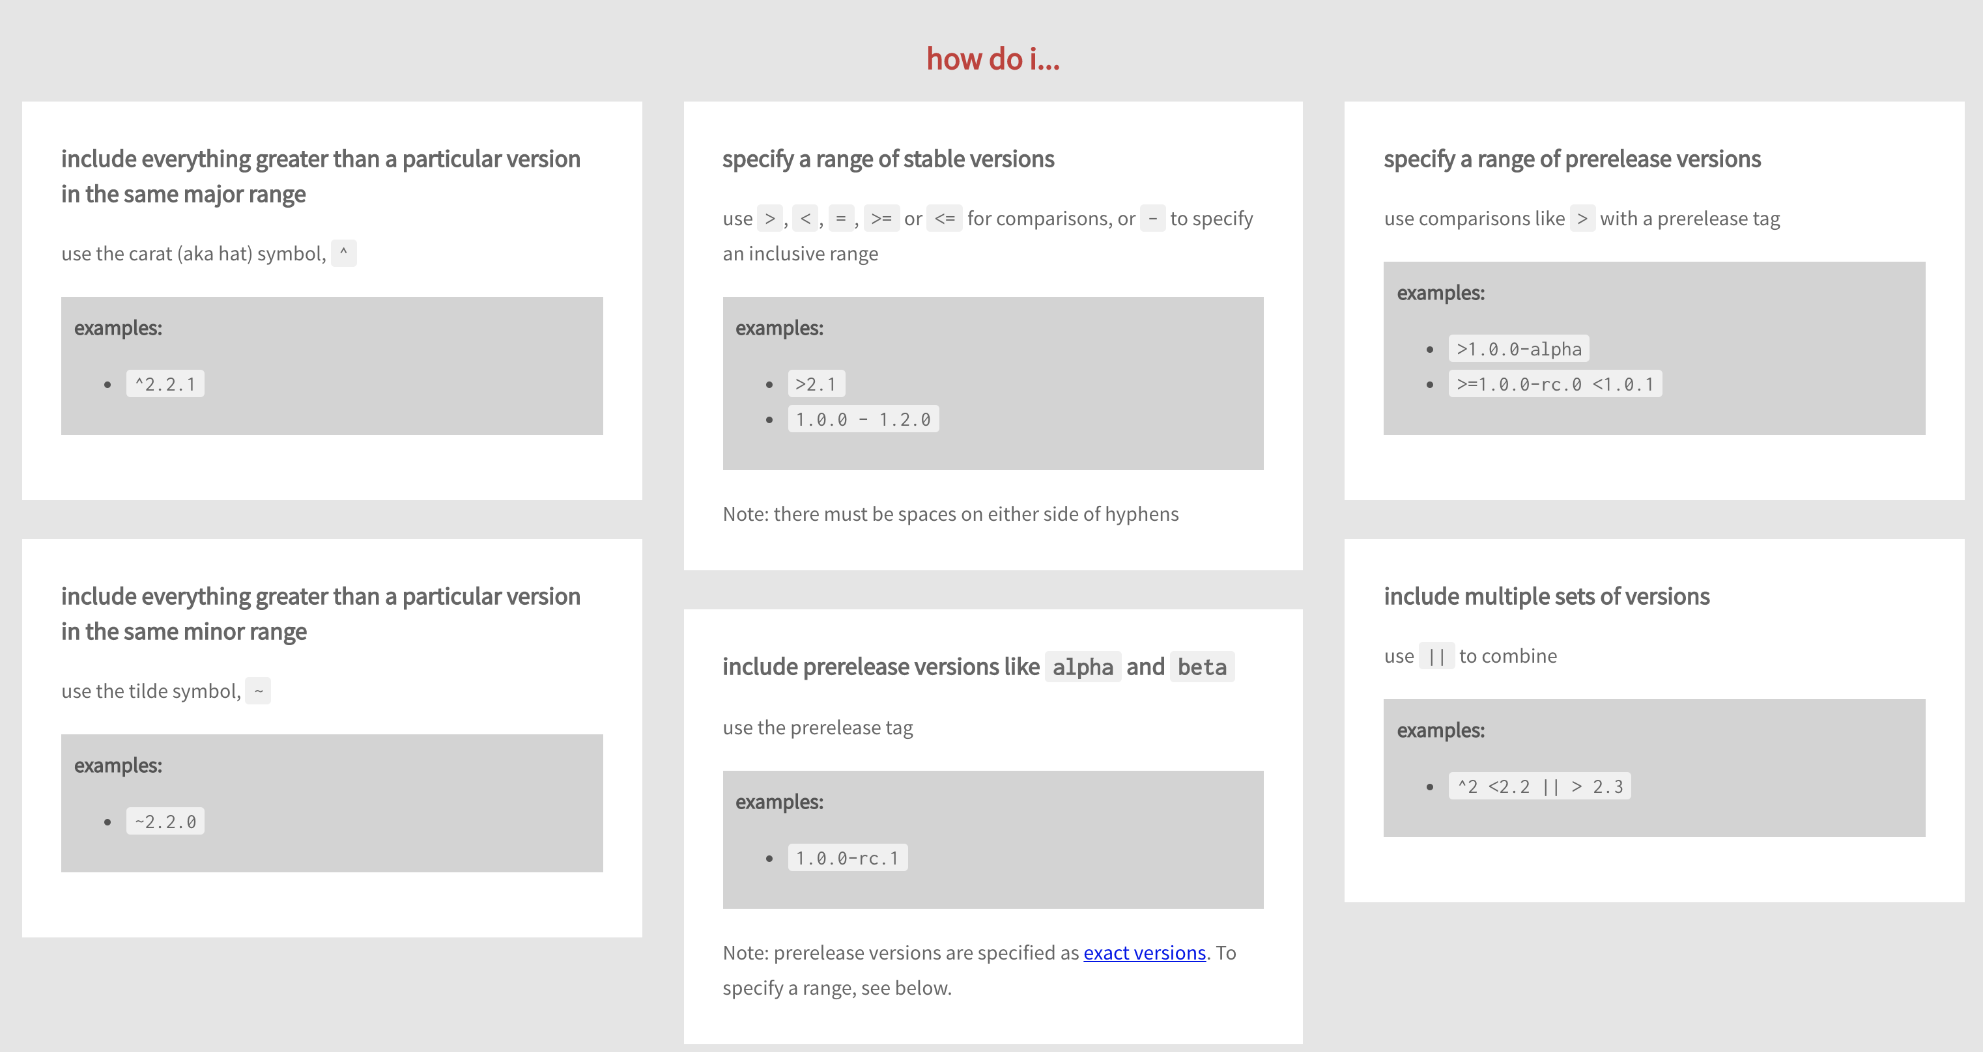


Using other packages - simplified
^ je default pri npm install
Niekoľko spôsobov ako to napísať

Slide 17
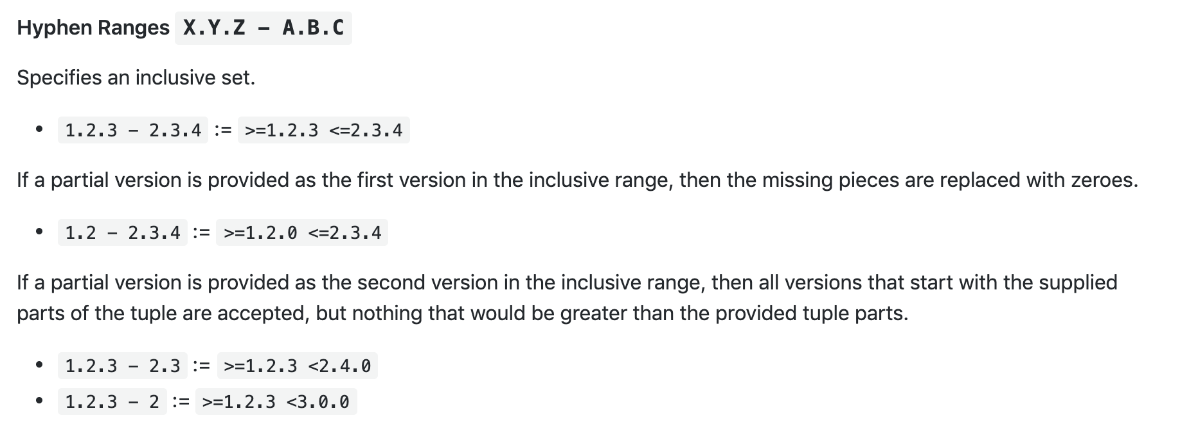
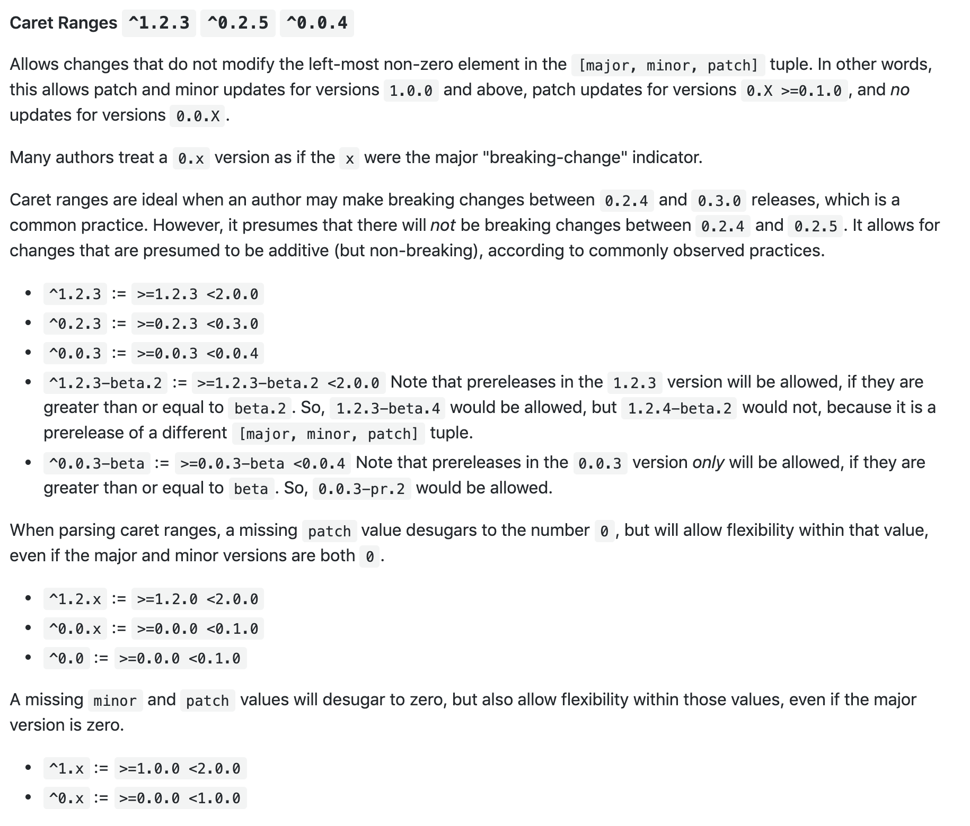
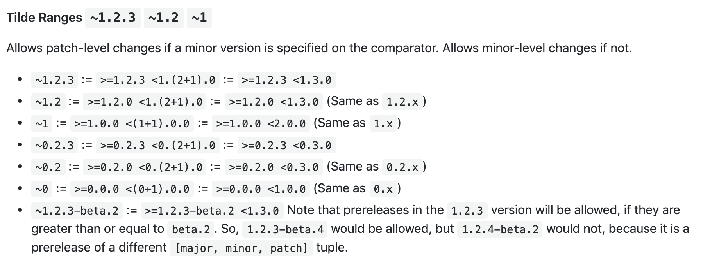
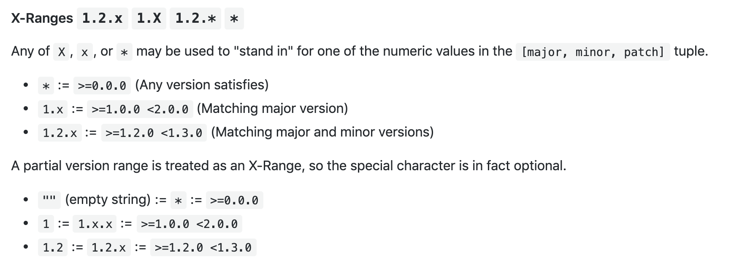







Using other packages – full truth
Pozor
^
sa správa inak pre 1 a 0
major release
https://github.com/npm/node-semver

Slide 18
Versioning – links
https://docs.npmjs.com/getting-started/semantic-versioning
https://semver.org
https://github.com/npm/node-semver
https://semver.npmjs.com
https://blog.npmjs.org/post/115305091285/introducing-the-npm-semantic-version-calculator

Slide 19

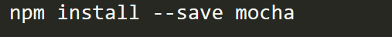
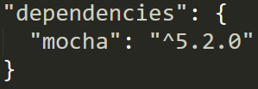
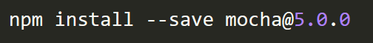
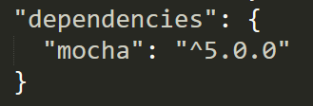
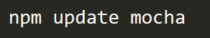
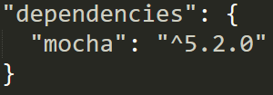
Versioning – Semantic Versioning
Ako používateľ nejakej package sa môžete rozhodnúť
akú verziu chcete nainštalovať
a aké updates chcete akceptovať
Výhodou a črtou npm je tranzitívne updatovanie závislostí v dependencies strome
^MINOR
latest
latest with 5.x.x

Slide 20
Versioning – Semantic Versioning
Výhodou a črtou npm je tranzitívne updatovanie závislostí v dependencies strome
Ale pozor to nie je úplne zadarmo a prináša to ďalšie komplikácie.
see next slides

Slide 21

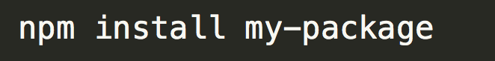
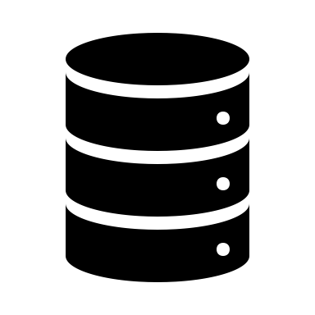
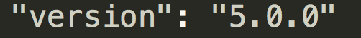
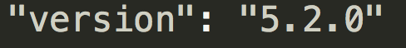
Versioning – reproducible installs
user A
mocha team
user B
my-package/package.json
publish
fixes
my-package/package.json
publish
install
node_modules/mocha/package.json
node_modules/mocha/package.json
Since minor and patch numbers only represent bugfixes and non-breaking additions, you should be safe to use any higher same-major version.

Slide 22
Versioning – reproducible installs
user A
mocha team
user B
my-package/package.json
publish
fixes
my-package/package.json
publish
install
node_modules/mocha/package.json
node_modules/mocha/package.json
...but maybe that bugfix affected functionality that we are using, and our application would produce different results when run with newer version. Now imagine this with multiple dependencies and dependencies of dependencies ....

Slide 23
Versioning – reproducible installs
Tých dôvodov prečo npm install nenainštaluje z toho istého package.json to isté node_module môže byť viac:
registry
package.json
node_modules
a new version of a direct semver-range package may have been published since the last time your packages were installed, and thus a newer version will be used.
different versions of npm (or other package managers) may have been used to install a package, each using slightly different installation algorithms.
A dependency of one of your dependencies may have published a new version, which will update even if you used pinned dependency specifiers (1.2.3 instead of ^1.2.3)
The registry you installed from is no longer available, or allows mutation of versions (unlike the primary npm registry), and a different version of a package exists under the same version number now.

Slide 24
Versioning – package locks
To prevent this potential issue, npm uses package-lock.json or, if present, npm-shrinkwrap.json.
These files are called package locks, or lockfiles
The file describes an exact, and more importantly reproducible node_modules tree.
Once it's present, any future installation will base its work off this file, instead of recalculating dependency versions off package.json
Using a locked package is no different than using any package without a package lock: any commands that update node_modules and/or package.json's dependencies will automatically sync the existing lockfile.
This includes npm install, npm rm, npm update, etc

Slide 25



Versioning – package locks
git
package developers
created by default
exact dependency tree when developing package from source code + readable dependency diffs
package-lock.json
registry
library user, coder
not locked
same format
only one shell be used
git
application end user
final applications published on npm, global installs, deamons, tools,
with locked versions
npm-shrinkwrap.json
registry
created by
npm-shrinkwrap
library user, coder
library, It's strongly discouraged for library authors. Prevents users from transitive updates
https://jpospisil.com/2017/06/02/understanding-lock-files-in-npm-5.htm, https://docs.npmjs.com/files/package-locksl

Slide 26
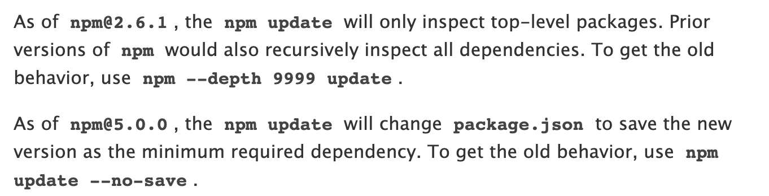

npm update https://docs.npmjs.com/cli/update.html
This command will update all the packages listed to the latest version (specified by the tag config), respecting semver.

Slide 27
npm scripts
Purpose
Samples
To controll application
start, stop, restart, test
To controll package
install, uninstall, publish, version, shrinkwrap
pre*, post* hooks
To do anything
for custom purposes, as shortcuts for the tools mostly
Each of can have pre* and post* hooks
TODO:

Slide 28
Package lifecycle scripts (npm scripts)
There are several variations of steps executed, they depend on:
installable type (registry, folder, git url)
install type
local
as transitive dependency
postpublish
prepack
publish
pack
postpack
postpack
pack
preinstall
prepack
install
postinstall
prepublishOnly
prepare
prepare
start, stop, restart
test
version
npm run mystep
https://www.keithcirkel.co.uk/how-to-use-npm-as-a-build-tool/

Slide 29
Package lifecycle scripts (npm scripts)
Installed
as dependency
npm install
<registry>
npm install
<git+ssh>
npm
publish
postpublish
prepack
preinstall
preinstall
publish
pack
install
install
postpack
postpack
postinstall
postinstall
pack
preinstall
prepublish
prepack
install
prepare
prepublishOnly
postinstall
prepare
https://docs.npmjs.com/misc/scripts
prepublish

Slide 30
npm scripts
Can be written using
Samples
npm binary from devDependencies
custom javascript code node ./script.js
bash or other shell
other exacutable on path
TODO:

Slide 31
npm cli - overview of commands
Working with your package |  |  | Installing Dependencies |  |  | Building and Publishing
init | create a package.json file |  | install | Install a package |  | build | Build a package
 |  |  | update | Update a package |  | rebuild | Rebuild a package
start | Start a package |  | uninstall | Remove a package |  | pack | Create a tarball from a package
restart | Restart a package |  | install-test | npm install + npm test |  | publish | Publish a package
stop | Stop a package |  | link | Symlink a package folder |  | version | Bump a package version
test | Test a package |  |  |  |  | dist-tag | Modify package distribution tags
run-script | Run arbitrary package scripts |  | ci | Install a project with a clean slate |  | deprecate | Deprecate a version of a package
 |  |  | install-ci-test | npm ci + npm test |  | unpublish | Remove a package from the registry
Configuration |  |  | Managing Dependencies |  |  | Searching registry
config | Manage the npm configuration files |  | ls | List installed packages |  | search | Search for packages
bin | Display npm bin folder |  | outdated | Check for outdated packages |  | view | View registry info
root | Display npm root |  | audit | Run a security audit |  | bugs | Bugs for a package in a web browser maybe
prefix | Display prefix |  |  |  |  | docs | Docs for a package in a web browser maybe
 |  |  | prune | Remove extraneous packages |  | repo | Open package repository page in the browser
cache | Manipulates packages cache |  | dedupe | Reduce duplication |  | star | Mark your favorite packages
 |  |  | shrinkwrap | Lock down dependency versions for publication |  | stars | View packages marked as favorites
completion | Tab Completion for npm |  | edit | Edit an installed package |  | hook | Manage registry hooks
 |  |  | explore | Browse an installed package |  | ping | Ping npm registry
 |  |  |  |  |  | doctor | Check your environments

Slide 32
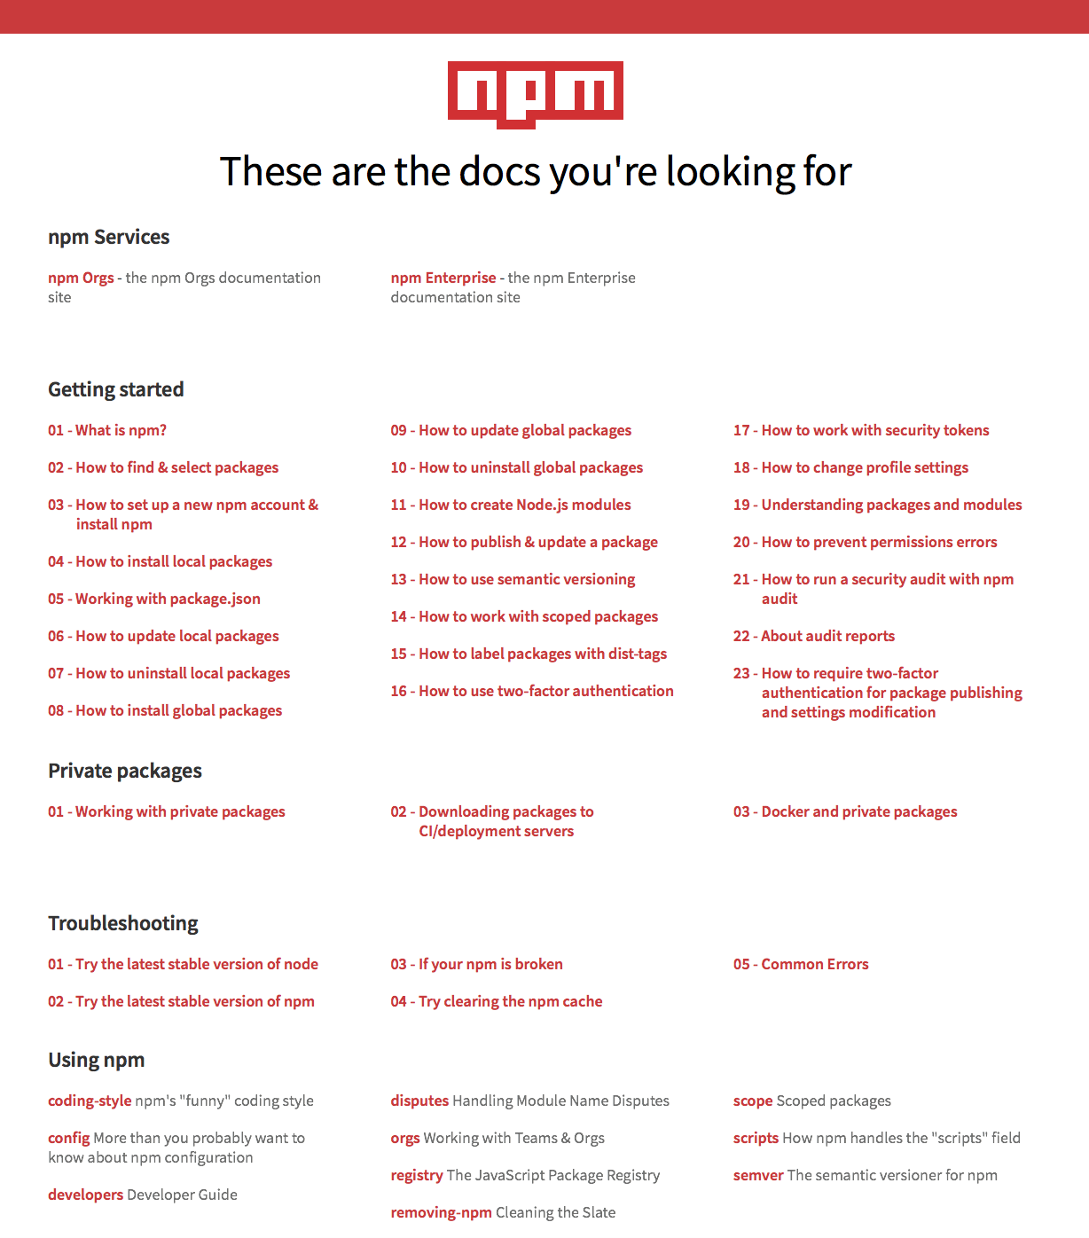
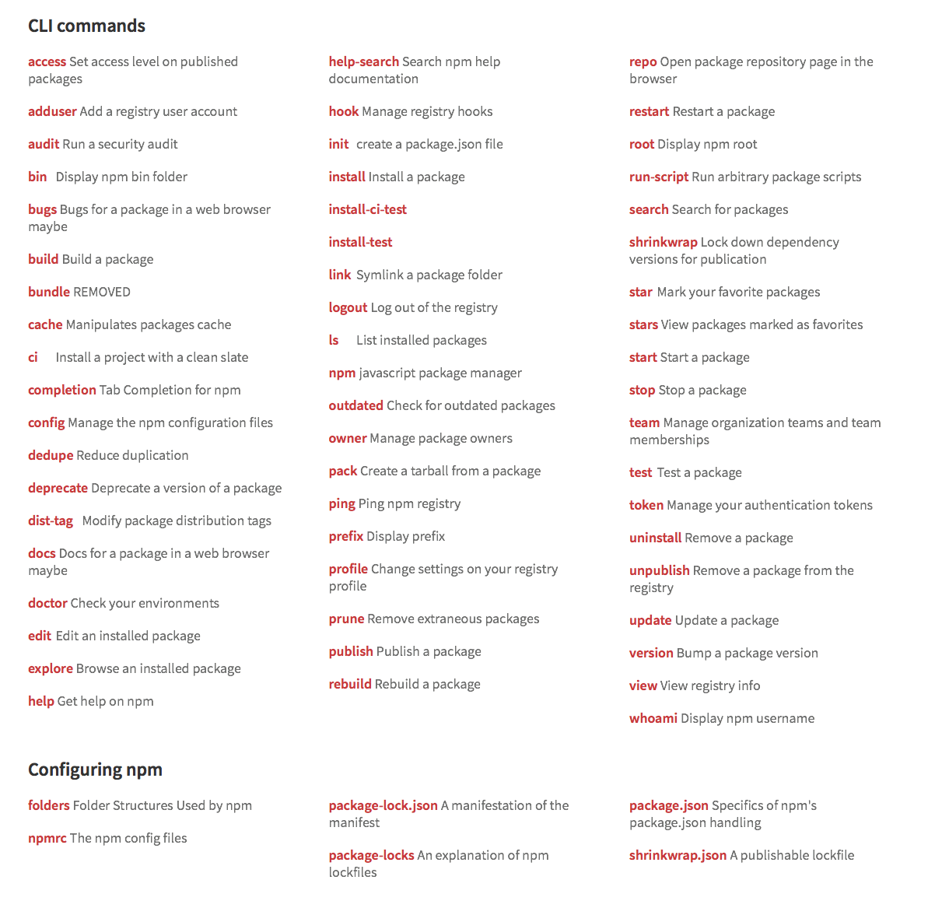
Docs, learn youself https://docs.npmjs.com

Slide 33
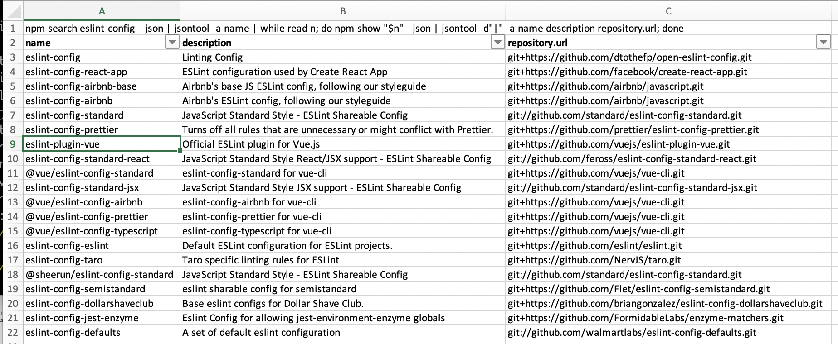
CLI Examples
npm search eslint-config --json | jsontool -a name | while read n; do npm show "$n" -json | jsontool -d"|" -a name repository.url description; done

Slide 34
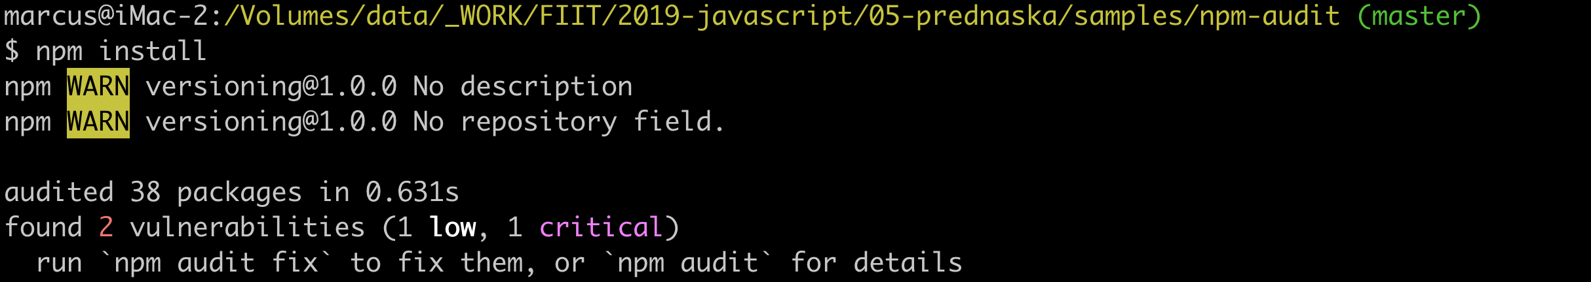
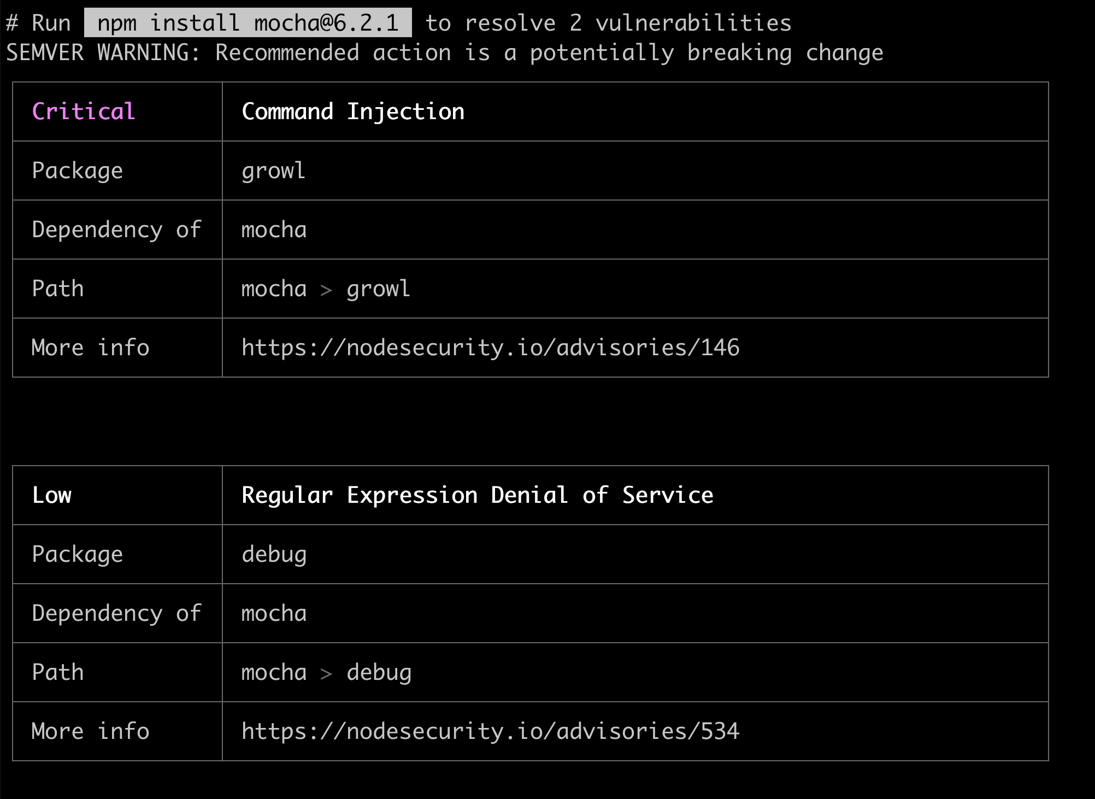
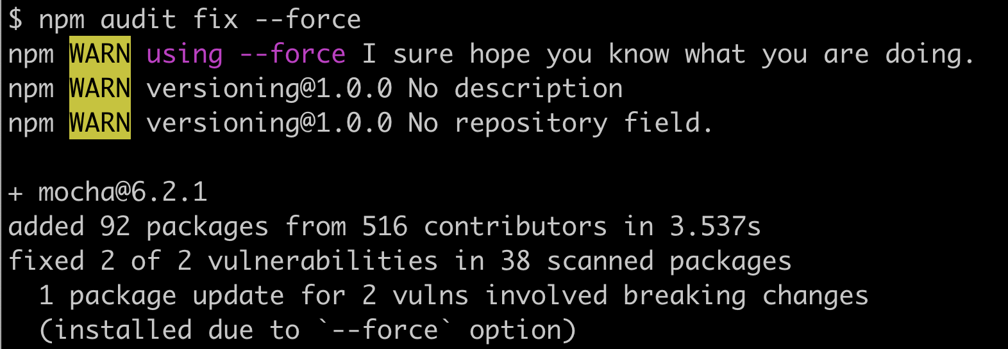
npm audit
Also as part of npm install
Scan your project for vulnerabilities and automatically install any compatible updates to vulnerable dependencies
Rôzne levely opráv od update transitive dependencies, update sem ver compatible až po úplný force

Slide 35
npx
execute npm package binaries
Executes <command> either from a local node_modules/.bin,
or from a central cache,
installing any packages needed in order for <command> to run.
Kým sme nemali npx, každý návod obsahoval npm install –g aby ste potom v konzole mohli napísať cheerio, mocha a podobne, teda aby ste executables z node packages mali na PATHe
Alebo sme písali ./node_modules/bin/mocha ...
teraz môžeme písať npx mocha a on si nájde binárnu

Slide 36
Registry
The npm public registry is powered by a CouchDB database, of which there is a public mirror at https://skimdb.npmjs.com/registry. The code for the couchapp is available at https://github.com/npm/npm-registry-couchapp.
TODO: interacting with registry in 2019, changes in architecture, lot of CouchDB views is deprecated now

Slide 37
Na skúšku
Rozumieť rozdielu medzi package a module, dokázať vysvetliť
Dokázať povedať účel scripts sekcie a niektorých vybraných fáz
Povedať aká verzia modulu sa nainštaluje podľa package.json
....

Slide 38

_aux

Slide 39
package.json#engines
You can specify the version of node that your stuff works on:
{ "engines" : { "node" : ">=0.10.3 <0.12" } }
if you don’t specify the version (or if you specify “*” as the version), then any version of node will do.
If you specify an “engines” field, then npm will require that “node” be somewhere on that list. If “engines” is omitted, then npm will just assume that it works on node.
You can also use the “engines” field to specify which versions of npm are capable of properly installing your program. For example:
{ "engines" : { "npm" : "~1.0.20" } }
Unless the user has set the engine-strict config flag, this field is advisory only and will only produce warnings when your package is installed as a dependency.

Slide 40
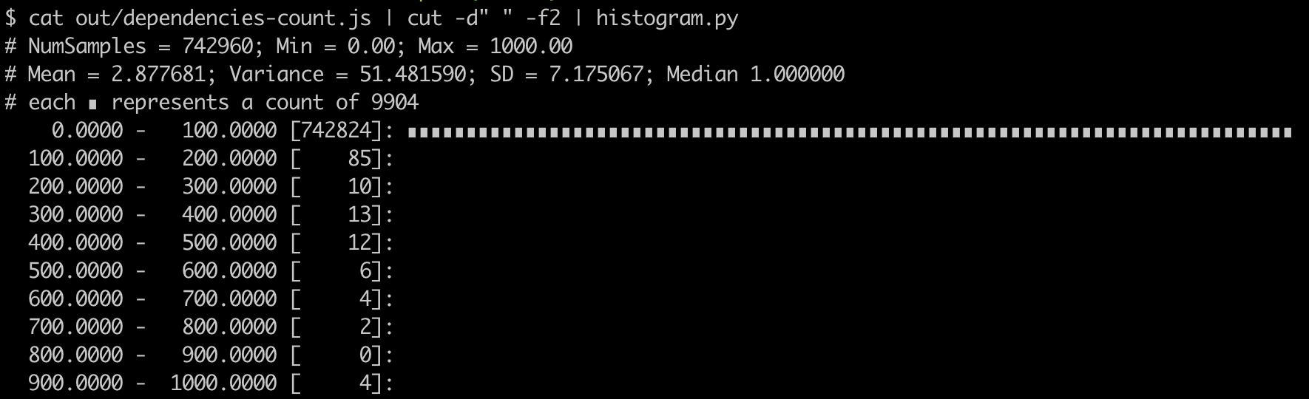
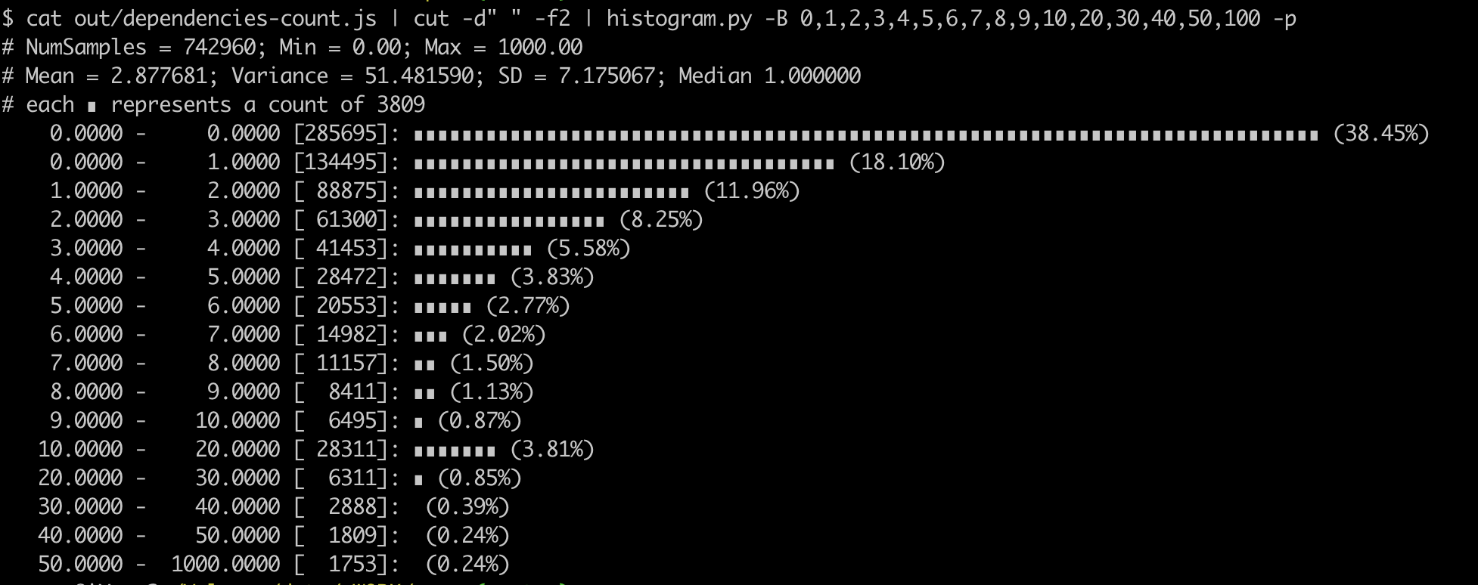
Dependencies
How many dependencies usually package have ?

Slide 41

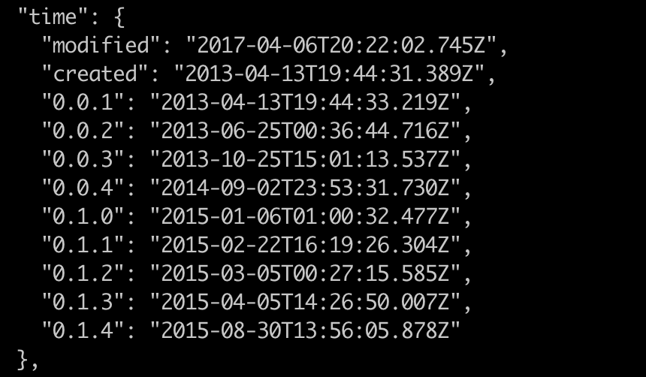
Abandonware
Abandonware is a product, typically software, ignored by its owner and manufacturer, and for which no support is available.

Slide 42
non-node packages on npm
Npm is used as package manager by many web developers
A lot of „packages“ are not node.js and will never run on node.js

Slide 43
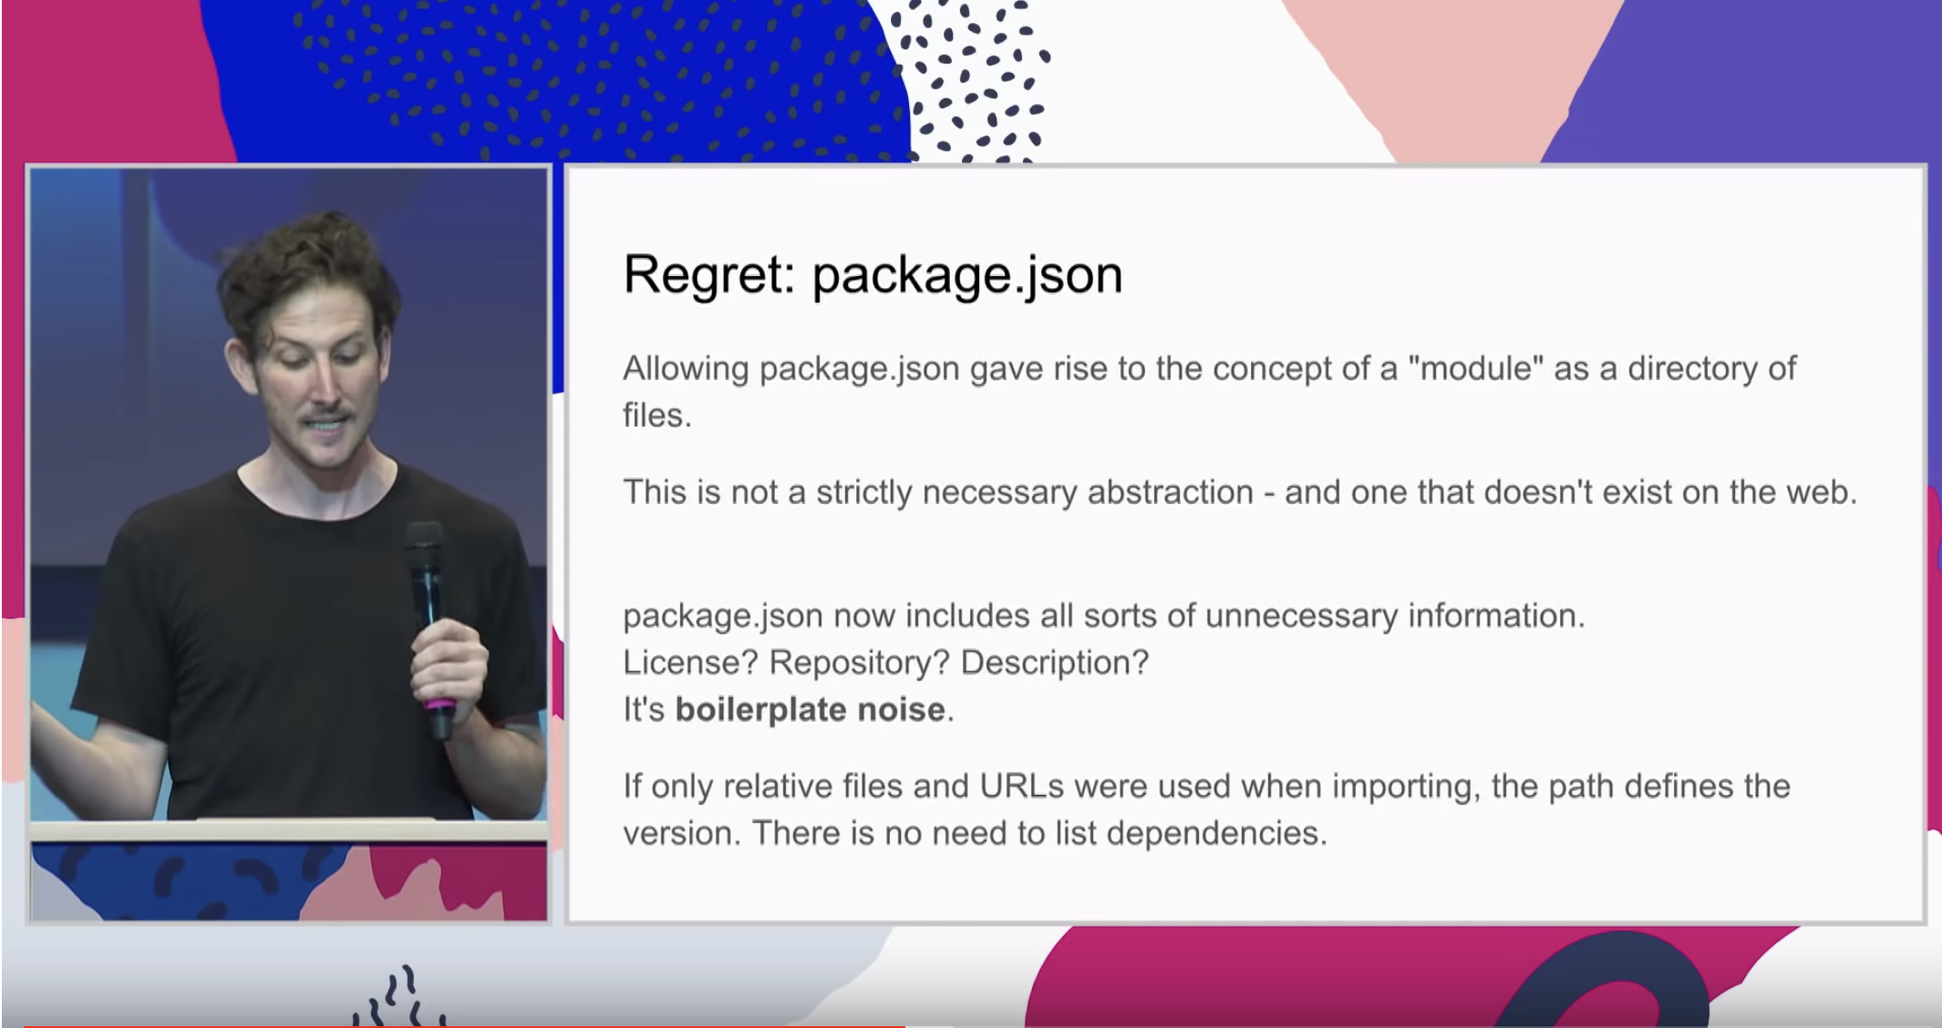
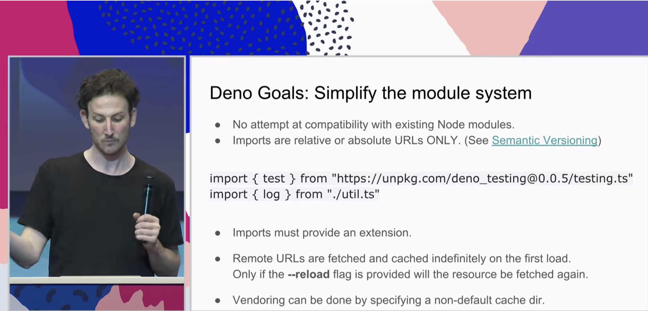
Ryan Dahl - JSConf EU 2018
https://www.youtube.com/watch?v=M3BM9TB-8yA

Slide 44
Package lifecycle scripts (npm scripts)
Installed
as dependency
npm install
<registry>
npm install
<git+ssh>
npm
publish
postpublish
prepack
preinstall
preinstall
publish
pack
install
install
postpack
postpack
postinstall
postinstall
pack
preinstall
prepublish
prepack
install
prepare
prepublishOnly
postinstall
prepare
https://docs.npmjs.com/misc/scripts
prepublish

Slide 45
Links
https://docs.npmjs.com/
https://www.sitepoint.com/beginners-guide-node-package-manager/
https://nec.is/writing/npm-authoring-basics/
https://github.com/npm/npm-lifecycle
https://medium.freecodecamp.org/introduction-to-npm-scripts-1dbb2ae01633
https://www.keithcirkel.co.uk/how-to-use-npm-as-a-build-tool/
https://medium.com/coinmonks/everything-you-wanted-to-know-about-package-lock-json-b81911aa8ab8

